Slide 1
Session 2.3: Indicators and Data
Adrian Matthew G. Glova
Assistant Professor
UP School of Statistics

Slide 2
Objectives
WHY, WHAT and HOW of data collection in Impact Evaluation:
Why do we need data to conduct rigorous evaluations?
What data points do we need to estimate impact?
How should data be collected to ensure validity?
Discuss the procedures and tools to collect high-quality data (e.g. data collection methods, instruments, sources)
Ensures that: (i) we are measuring the right outcomes and predictors, and (ii) we have enough data to arrive at an impact estimate

Slide 3
Outline for Today
Motivation: role of data in impact evaluation
Unit of Assignment, Treatment, and Analysis
Evaluation Question and Performance Indicators
Toy Example: New Math Curriculum
Data Collection and Sampling Design
Data Management
Data Required for Different Impact Measures (if time permits)
Case Study: School-Based Feeding Program (Tabunda et al., 2016)

Slide 4
Primary References
White, H., and D. Raitzer. 2017. Impact Evaluation of Development Interventions: A Practical Guide. Manila, Philippines: Asian Development Bank. https://www.adb.org/sites/default/files/publication/392376/impact-evaluation-development-interventions-guide.pdf
Gertler, Paul J., Sebastian Martinez, Patrick Premand, Laura B. Rawlings, and Christel M. J. Vermeersch. 2016. Impact Evaluation in Practice, second edition. Washington, DC: Inter-American Development Bank and World Bank. https://openknowledge.worldbank.org/server/api/core/bitstreams/4659ef23-61ff-5df7-9b4e-89fda12b074d/content
Khandker, S., G. Koolwal, and H. Samad. 2009. Handbook on Impact Evaluation: Quantitative Methods and Practices. Washington, DC: World Bank. https://openknowledge.worldbank.org/bitstream/handle/10986/2693/520990PUB0EPI1101Official0Use0Only1.pdf.

Slide 5
Warmup muna!

Slide 6
Warmup!
Prize: PhP500 Starbucks Gift Card to the highest scorer
In case there’s a tie, we will use randomization to select a single winner ☺
T or F: Write T if the statement is unconditionally true, F if otherwise:
The counterfactual can be observed
Unit of treatment and unit of assignment are at the same observational level
Convenience sampling may be utilized for impact evaluation
A type I error equates to rejecting a true null hypothesis (i.e. false positive)
Baseline data are not important for impact evaluation
I’ll give you 5 minutes to answer the 5 questions above

Slide 7
Warmup!
Prize: PhP500 Starbucks Gift Card to the highest scorer
In case there’s a tie, we will use randomization to select a single winner ☺
T or F: Write T if the statement is unconditionally true, F if otherwise:
The counterfactual can be observed - F
Unit of treatment and unit of assignment are at the same observational level - F
Convenience sampling may be utilized for impact evaluation - F
A type I error equates to rejecting a true null hypothesis (i.e. false positive) - T
Baseline data are not important for impact evaluation - F
I’ll give you 5 minutes to answer the 5 questions above

Slide 8
Role of Data in Impact Evaluation

Slide 9
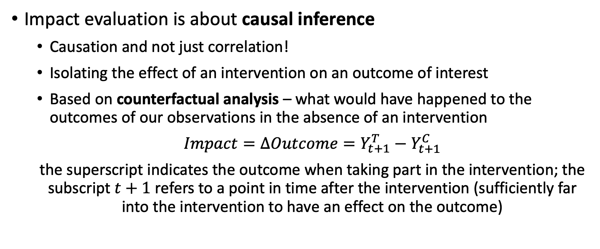
Impact Evaluation Concepts
Impact evaluation is about causal inference
Causation and not just correlation!
Isolating the effect of an intervention on an outcome of interest
Based on counterfactual analysis – what would have happened to the outcomes of our observations in the absence of an intervention
$Impact=∆Outcome=Y_{t+1}^{T}−Y_{t+1}^{C}$
the superscript indicates the outcome when taking part in the intervention; the subscript $t+1$ refers to a point in time after the intervention (sufficiently far into the intervention to have an effect on the outcome)

Slide 10
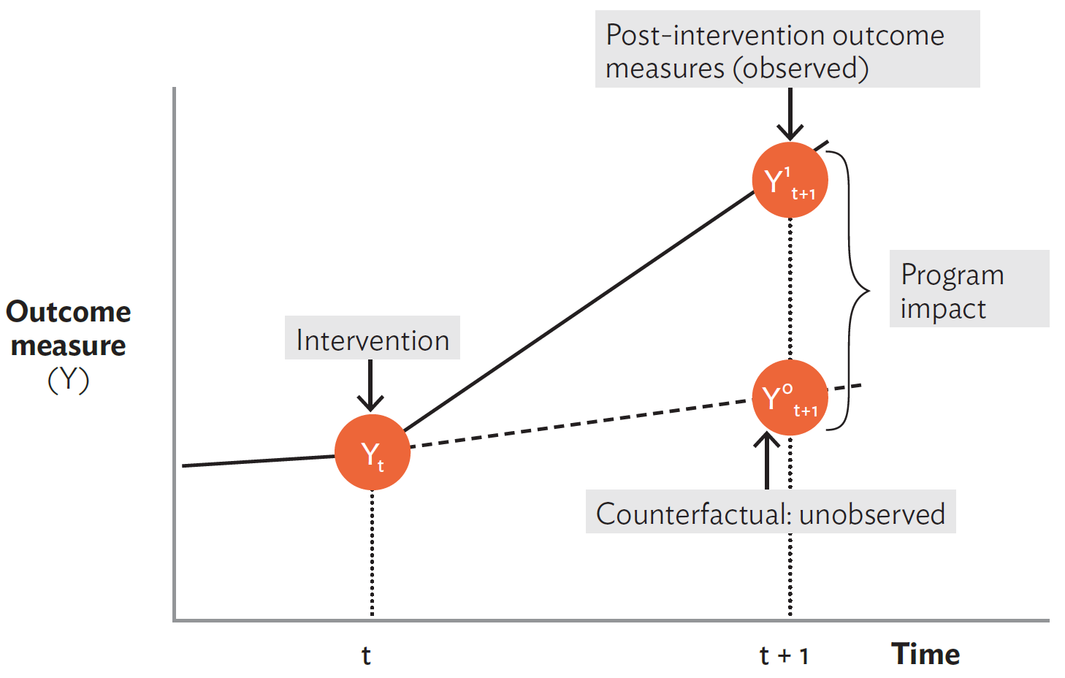
Impact Evaluation Concepts
Source: White and Raitzer (2017).

Slide 11
Impact Evaluation Concepts
Impact Evaluation relies on potential outcomes
Imagine creating a perfect clone for the household/firm/person of interest prior to the intervention
The treatment and control units will have equal observable traits (e.g. age, income, sex, gender, number of children, years of schooling)
For a perfect clone, even unobservables will be the same (e.g. motivation, risk aversion, talent, friendliness, entrepreneurship)
The change in outcomes will then be purely due to the intervention
Evaluation Problem: the counterfactual cannot be observed
Solution: We estimate the counterfactual based on empirical data

Slide 12
Role of Data in Impact Evaluation
Counterfactual: data will be used to construct a counterfactual that is statistically indistinguishable with the treatment group
A comparison group that is on average the same as the treatment group
Selection bias – determinants of selection into the program are correlated with outcomes of interest
Contamination – presence or introduction of other interventions
Spillover effects – stable unit treatment value assumption (SUTVA) such that an observation’s potential outcome depends only on their treatment status
Estimating impact: data on outcomes will be taken from the treatment group and the comparison (control) group

Slide 13
Unit of Assignment, Treatment and Analysis

Slide 14
“Units” in Impact Evaluation
Unit of Assignment – the lowest unit at which an intervention is assigned (typically geographic or administrative regions)
Unit of Treatment – the unit to which the treatment is delivered; may be at a lower level than the unit of assignment
Unit of Analysis – the unit in which outcomes are measured; may also be lower than the unit of assignment or treatment
Unit of analysis yields the required granularity of the data

Slide 15
“Units” in Impact Evaluation
Program | Assignment | Treatment | Analysis
Deworming program | Village | Households | Households and children
Conditional Cash Transfer program | Province | Households | Households and children
Microfinance program | Microfinance institutions and development banks | Small and Medium Enterprises (SMEs) | Employees of SMEs
Farm-to-market road | Municipality | Barangays | Farmers, consumers
The “units” will be based on program design and implementation

Slide 16
Getting the Right Data: Evaluation Question and Outcome Indicators

Slide 17
Evaluation Question
Impact is the change in outcomes directly attributable to a program
Need for a well-defined, testable and quantifiable hypothesis
Data generates evidence to test the hypothesis
But what data should we obtain? The Theory of Change (ToC) provides guidance:
The ToC reflects contextual information that will lead to the “right data”
Results chain should be used to identify indicators
The evaluation question is rooted in the outcomes we want to evaluate

Slide 18
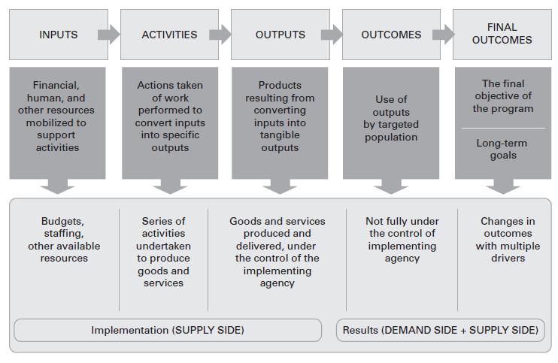
Results Chain to Evaluation Question
Source: Gertler et al. (2016).

Slide 19
Evaluation Question
Two types of evaluation questions:
First Generation: Is the program effective in changing outcomes of interest?
Second Generation: Which program modality is the most effective or cost-effective in changing an outcome of interest?
There is often a natural progression in going from first generation to second generation questions
Initially, we want to ascertain and establish that a program works
We then advance its effectiveness to see which modality works best
Example: Did the CCT increase household food expenditures by 5%?

Slide 20
Results Chain to Evaluation Question
What are the inputs?
These are the resources at the disposal of the project
May include human resources, financial resources, and physical assets
What are the program activities?
These are the actions, processes, and work performed to transform inputs into outputs
What are the outputs?
These are the tangible goods and services that the activities produce

Slide 21
Results Chain to Evaluation Question
What are the outcomes?
Immediate results likely to be achieved once the beneficiary population uses the project outputs (short-term outcomes)
We also consider medium-term and long-term outcomes
Unit of analysis determines the level at which we’ll measure outcomes
Collectively, the short, medium, and long-term outcomes are the results we want to measure
Results are not directly under the control of the implementing agency
Results are also dependent on behavioral changes by beneficiaries

Slide 22
Selecting Outcome Indicators
The outcome indicators will be the criteria for success of a program
Outcome indicators should be SMART:
Specific – the information should be well specified and is not vague
Measurable – the information can be readily obtained
Attributable – the indicator is linked to the implementation of the program
Realistic – the information can be obtained in a timely manner, at a reasonable frequency and at a reasonable cost
Targeted – the indicator applies to the targeted population

Slide 23
Selecting Implementation Indicators
Implementation indicators should also be identified at every stage of the results chain. Implementation indicators ensure that:
The program inputs were actually available to the implementing agency
The program activities were carried out as planned
The outputs were delivered on time and on target to the identified beneficiaries
Implementation indicators will provide context on why the predicted/intended impact was realized (or wasn’t realized)
If the inputs, activities and outputs were not delivered as planned, can we accurately judge the effectiveness of an intervention?

Slide 24
Performance Indicators
Source: Gertler et al. (2016).

Slide 25
Checklist: Getting the Right Data
Are the indicators, especially on results, aligned with the ToC?
Are the indicators SMART?
What is the data source for each indicator? (e.g. survey, administrative data, data from a previous study)
Who will collect the performance data?
What resources will be required to collect said data?
Who will clean, interpret, and report the data?
Who will store, manage and document the data?

Slide 26
Toy Example: Evaluating the Impact of a New Math curriculum

Slide 27
Impact Evaluation Scenario
Scenario: The Department of Education is thinking of revamping the High School Mathematics curriculum. This curriculum is supposed to improve students’ performance on standardized mathematics tests, and ultimately, improve students’ ability to complete high school, access better jobs, and earn higher incomes. For teachers, the revamped Math curriculum is also supposed to be easier to deliver.

Slide 28
Identifying the “Units” of Evaluation
Units of evaluation should be based on the program design
Program | Unit of Assignment | Unit of Treatment | Unit of Analysis
New Mathematics Curriculum | Provinces | Schools | Teachers and children
 | Treatment is piloted to the 20% poorest villages identified by the implementing agency | Treatment is delivered to schools as learning materials and training are provided there | Treatment is supposed to improve the education and social mobility outcomes of children; teachers should have an easier administrative load

Slide 29
Evaluation Problem
What would have been the learning outcomes of the (same) student-beneficiaries had they studied under the old Math curriculum?
Again, the counterfactual cannot be observed. An observation unit cannot have simultaneous existences
Solution: we estimate the counterfactual with sample data

Slide 30
Results Chain to Evaluation Question
Inputs | Activities | Outputs | Outcomes (Short and Medium-Term) | Final Outcomes
Teaching and non-teaching staff | Math curriculum development | Teachers trained | Teachers’ use of new Mathematics curriculum | College completion rates of student-beneficiaries
Budget for the program | Teacher training program on the new curriculum | Textbooks and learning materials delivered | Teachers’ use of new Mathematics textbooks and learning materials | Employment rates of student-beneficiaries
Facilities where the teachers will be trained | Actual training of teachers | Standardized tests adapted to the new curriculum | Student-beneficiaries’ performance in standardized tests | Income of student-beneficiaries
Facilities and gadgets that the students may require | Drafting, printing and distribution of new textbooks and learning materials |  | High School completion rates of student-beneficiaries

Slide 31
Results Chain to Evaluation Question
The evaluation questions are rooted in the ToC, particularly the outcomes of interest:
What is the effect of the new mathematics curriculum on test scores?
What is the effect of the new mathematics curriculum on completion rates, access to jobs, and earnings?
The evaluation question is of the first kind (establishing effectiveness)
This is a pilot implementation rather than an expansion
It can be reframed into the second kind if there’s an alternative Math curriculum being developed (ex. Hybrid remote-physical delivery)

Slide 32
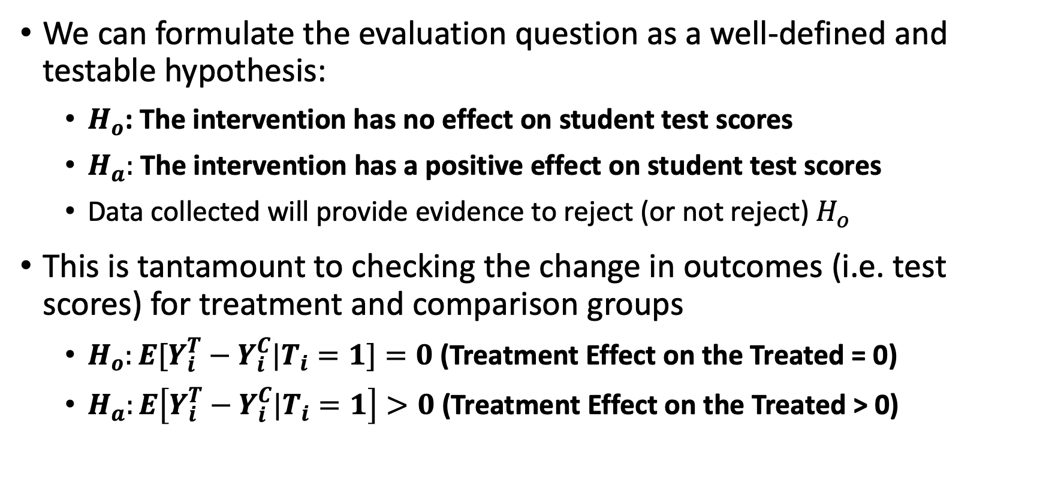
Results Chain to Evaluation Question
We can formulate the evaluation question as a well-defined and testable hypothesis:
$H_{o}$: The intervention has no effect on student test scores
$H_{a}:$ The intervention has a positive effect on student test scores
Data collected will provide evidence to reject (or not reject) $H_{o}$
This is tantamount to checking the change in outcomes (i.e. test scores) for treatment and comparison groups
$H_{o}:E[Y_{i}^{T}−Y_{i}^{C}|T_{i}=1]=0$ (Treatment Effect on the Treated = 0)
$H_{a}:E\left[Y_{i}^{T}−Y_{i}^{C}|T_{i}=1\right]>0$ (Treatment Effect on the Treated > 0)

Slide 33
Selecting Outcome Indicators
Some vague evaluation questions with poor outcome indicators:
What is the effect of the new mathematics curriculum on students’ performance? (not specific enough)
What is the effect of the new mathematics curriculum on students’ success? (difficult to measure)

Slide 34
Selecting Outcome Indicators
Some vague evaluation questions with poor outcome indicators:
What is the effect of the new mathematics curriculum on students’ mental health? (may not be realistic as privacy and concerns may hamper data collection; not attributable)
What is the effect of the new mathematics curriculum on teachers’ administrative load? (not targeted to the primary target population – students – on which final outcomes will be measured UNLESS this is the main objective)

Slide 35
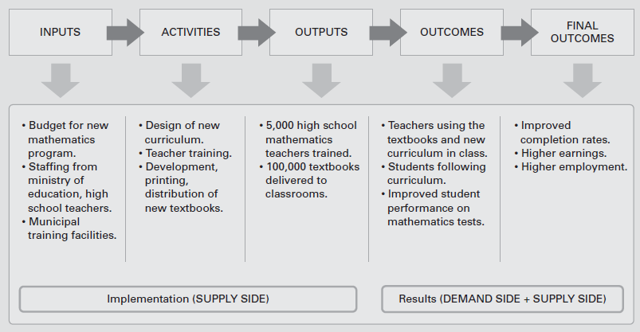
Performance Indicators
Source: Gertler et al. (2016).

Slide 36
Selecting Implementation Indicators
Implementation indicators support the realization of final outcomes
We can directly control implementation, but can only influence final outcomes as they require behavioral change from beneficiaries
In our example, we can control the budget and personnel (inputs), the curriculum development and teacher training development (activities), and the delivery of learning materials and number of teachers trained (outputs)
However, it would be the students who would take the standardized tests (short-term outcome), and the students who would later be completing their education, looking for jobs and earning their incomes (medium to long-term outcomes)

Slide 37
Metadata: Data on our Data
Indicator | Unit of Observation | Results Chain Level | Data Source | Collecting Agency | Frequency | Data Cleaning | Data Storage Format | Reporting Agency
Program Disbursements (mPhP) | Program | Inputs | Administrative Data | Department of Budget and Management; Department of Education | Monthly | Department of Education | .xls file | Department of Education
Annual average income | Household | Final Outcomes | Survey | Philippine Statistics Authority; NGO | Annual | Philippine Statistics Authority; NGO | .dta file | Philippine Statistics Authority

Slide 38
Getting the Data Right: Data Collection Methods and Sources

Slide 39
Importance of High-Quality Data
The quality of the impact evaluation is only as good as the data
Good impact evaluation design has to be accompanied with good data collection and management practices
Poor data integrity, insufficient observations, and data that lack richness can make impact evaluations inaccurate if not impossible
Missing data, sampling errors, encoding errors, respondent inaccuracy
Insufficient observations and underpowered studies
Impact heterogeneity

Slide 40
Data Sources
Census
Data collected from the entire population
May provide us with a sampling frame which can be used to construct a comparison group
A sampling frame is a comprehensive list of all elements in a statistical population
Concern: census data are typically available every 10 years. In other cases, census data may not be available

Slide 41
Data Sources
Sample Surveys
Data is collected by asking people (respondents) questions
Respondents are identified by probabilistic/random sampling
Random sampling yields a sample that may represent the population of interest (subject to some margin of error)
The population of interest would be the targeted beneficiary population
Random sampling is more practical (logistics, costs, time) vs census
Sampling may be done for the treatment group and comparison group to estimate the program impact

Slide 42
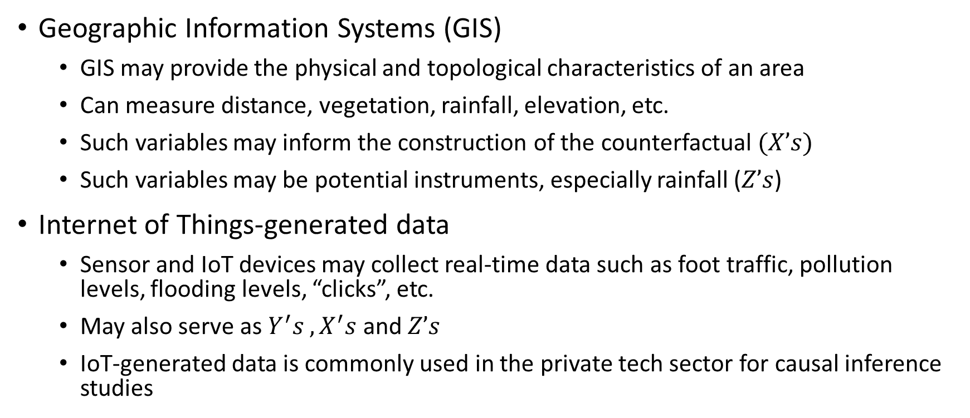
Data Sources
Geographic Information Systems (GIS)
GIS may provide the physical and topological characteristics of an area
Can measure distance, vegetation, rainfall, elevation, etc.
Such variables may inform the construction of the counterfactual $(X’s)$
Such variables may be potential instruments, especially rainfall ($Z’s$)
Internet of Things-generated data
Sensor and IoT devices may collect real-time data such as foot traffic, pollution levels, flooding levels, “clicks”, etc.
May also serve as $Y^{′}s , X^{′}s$ and $Z’s$
IoT-generated data is commonly used in the private tech sector for causal inference studies

Slide 43
Data Sources
Administrative data
Information routinely tracked by organizations as part of statistical or information management systems
Examples would be the number of learners, classrooms, school buildings being tracked by DepEd; the number of kilometer roads tracked by the DPWH; revenue collections and disbursements by the BTr
Administrative data, provided detailed enough, is a common source of impact evaluation data

Slide 44
Data Sources
Many impact evaluations use primary data collected via surveys as other data sources may not contain all the needed variables
An impact evaluation data source should at least contain variables on outcomes, conditioning variables to estimate the counterfactual, and possible instruments
It’s possible to combine multiple data sources provided there is a unique identifier for each observation
Example: it’s possible to combine tax filing data and survey data if there’s an individual ID

Slide 45
Baseline Data
Impact evaluations are stronger with baseline data
Provides data on observables to construct the counterfactual
Tests for balance between treatment and comparison groups
May utilize administrative data, GIS data, or existing survey data in the absence of primary baseline data
Some data can be collected by recollection, such as educational attainment, household members, sex of household head, etc. (use with caution)

Slide 46
Role of Qualitative Data
Qualitative data may provide context and help inform the impact evaluation
Qualitative data can capture sensitive or difficult-to-measure nuances
Implementation concerns (e.g. elite capture, favoritism, leakages)
Barriers to participation (e.g. social norms, gender roles)
Impact evaluations are sometimes accompanied by process evaluations and follow-up qualitative studies
Example: 4Ps program has had 4 waves of impact evaluation, alongside multiple process and qualitative evaluations
Later, we will explore a mixed-methods study

Slide 47
Sampling Design

Slide 48
Sampling Design
Sampling will be crucial in collecting primary data through surveys
The random sample must be representative of the population
The sampling frame is the list from which respondents will be selected
The elementary unit is a member of the population whose measurement on the variable of interest is what we wish to examine.
The sampling unit is the unit of the population that we select

Slide 49
Sampling Design
The sampling design should follow from the evaluation design (not the other way around)
The same way that the evaluation design should follow the program design
Example: A cluster randomized control trial (RCT) will require a cluster sampling design
The sampling design must allow the identification of treatment and control groups, as well as those exposed to spillover effects
These should be tracked as they are different from treatment and comparison groups
The sampling design should consider impact heterogeneity
Subgroups of interest should be tracked to estimate differentiated impact on different groups (e.g. by sex, income decile, age)

Slide 50
Two Methods of Sampling
Probability Sampling is method of selecting a sample wherein each element of the population has a known, non-zero chance of selection
Non-probability sampling is a method of selecting a sample wherein some elements of the population do not have a known chance of inclusion in the sample or the chance is zero
This would include convenience and purposive sampling
Probability sampling is used for impact evaluations so that the random sample will be representative of the population

Slide 51
Some Methods of Probability Sampling
Simple random sampling (SRS)
Stratified sampling
Cluster sampling
Multi-stage sampling
Systematic sampling

Slide 52
Simple Random Sampling
In simple random sampling (SRS), a subset of elements (sample) is randomly selected from the population of interest
All the elements of the population have the same probabilities of inclusion in the selected sample
“Equiprobable chances of selection”
Common examples would be a lottery, a random draw of from a list of names, and any scheme where every element has an equal chance of selection

Slide 53
Simple Random Sampling
SRS is easy to execute and understand.
SRS is effective if the population is fairly homogenous. What if the population is heterogeneous?
SRS may be impractical if the area covered in the study is very large
It may be difficult to obtain a list of all the elements in the population (i.e. no sampling frame)

Slide 54
Stratified Random Sampling
In stratified sampling we divide the population into non-overlapping strata, and then select a sample from each stratum
If the sample selection procedure is SRS for all of the strata, then we refer to this method as stratified random sampling (StRS)
Choice of stratification variable → “homogenous within each stratum, heterogenous between strata”
Choice of strata may facilitate the administration and supervision of data collection (e.g., geographic subdivision)

Slide 55
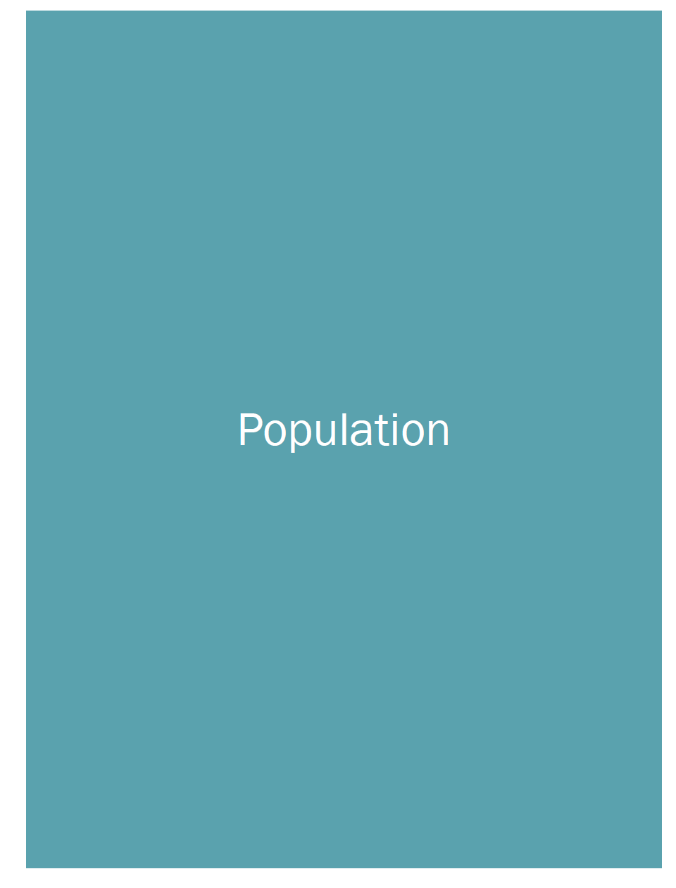
Stratified Random Sampling

Slide 56
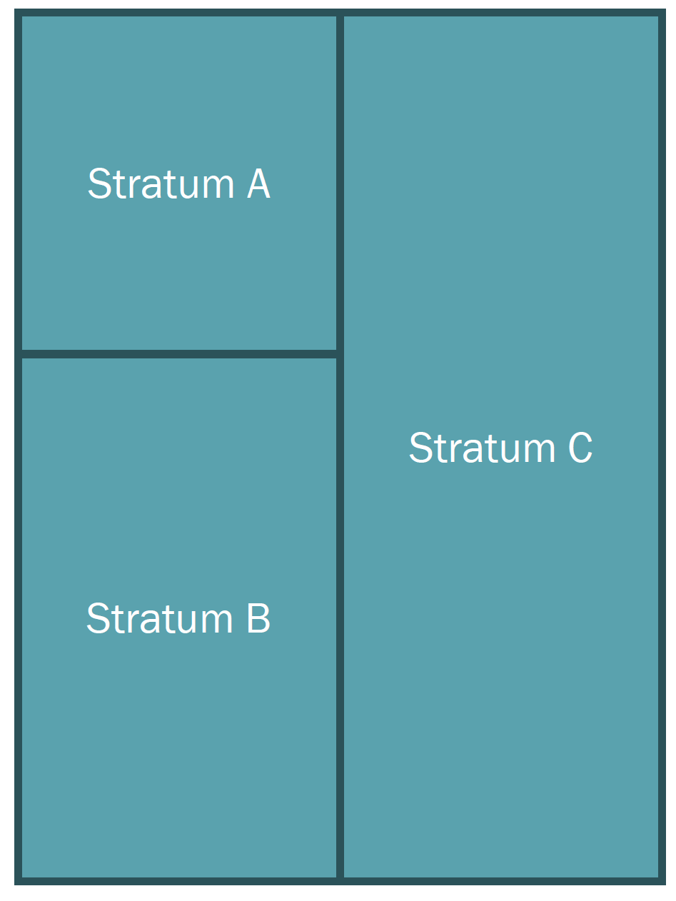
Stratified Random Sampling
We divide the population into non-overlapping strata
Every stratum is homogenous within, but heterogenous between.
Common stratification variables would be geographic (e.g. island groups) or socio-economic (e.g. income classes) variables

Slide 57
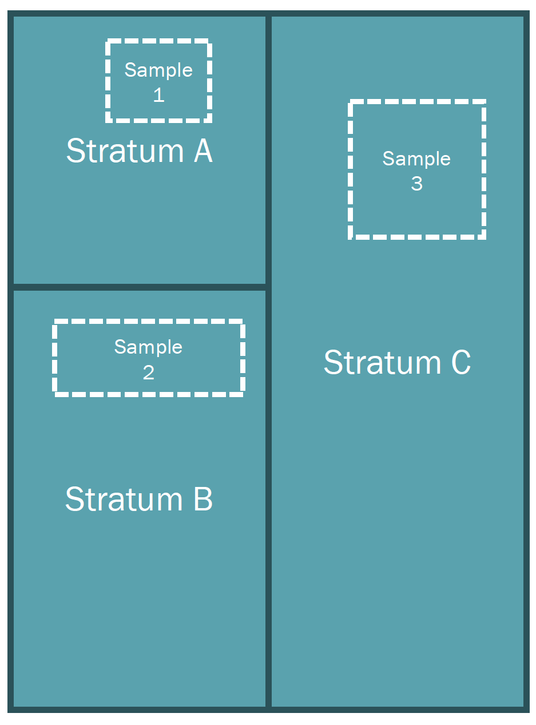
Stratified Random Sampling
After dividing the population into non-overlapping strata, we get a sample from each stratum
Since each stratum is homogenous within and heterogenous between, we can obtain a “representative sample”
If we stratify by island group, we get representatives from Luzon, Visayas, and Mindanao

Slide 58
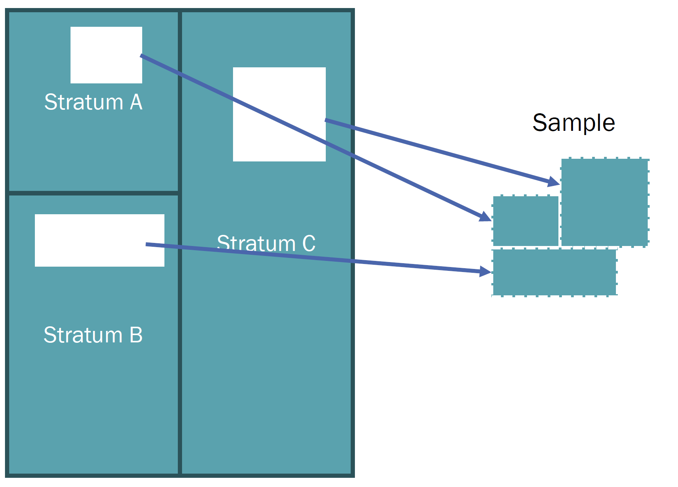
Stratified Random Sampling
Putting the sub-samples from each stratum together, we obtain our random sample

Slide 59
Cluster Sampling
Cluster sampling is a sampling method where we divide the population into non-overlapping clusters, and then select a sample of clusters
The sample will consist of all, if not most, of the elements in the selected clusters
The sampling units in cluster sampling are the clusters and not the elements
If the clusters are selected using SRS, then this is called single-stage cluster sampling (SSCS)

Slide 60
Cluster Sampling
Clusters are heterogeneous within, and homogenous between. We randomly select the clusters and we get the elements from these clusters
Since the clusters are designed as such, sampling a few clusters will yield a representative sample
Cluster sampling is more convenient since the sampled units will be geographically close to each other
Different levels in the unit of assignment and unit of analysis creates clusters around the location of the intervention

Slide 61
Cluster Sampling

Slide 62
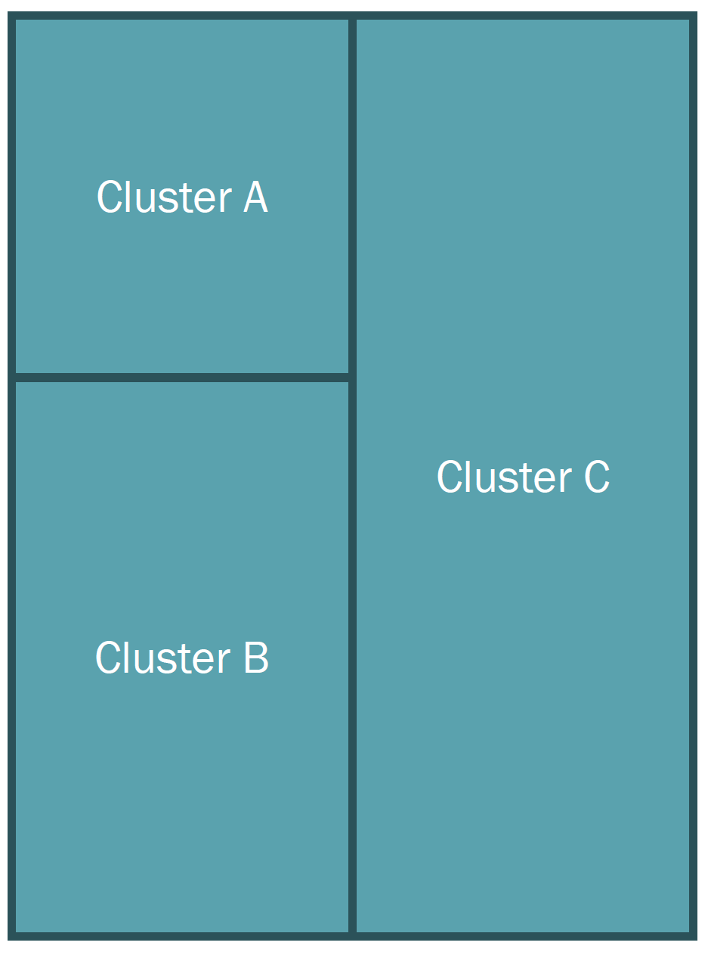
Cluster Sampling
We divide the population into non-overlapping clusters
Every cluster is heterogenous within, but homogenous between
Clustering is commonly done via geographic or administrative boundaries (e.g. provinces, municipalities, barangays)

Slide 63
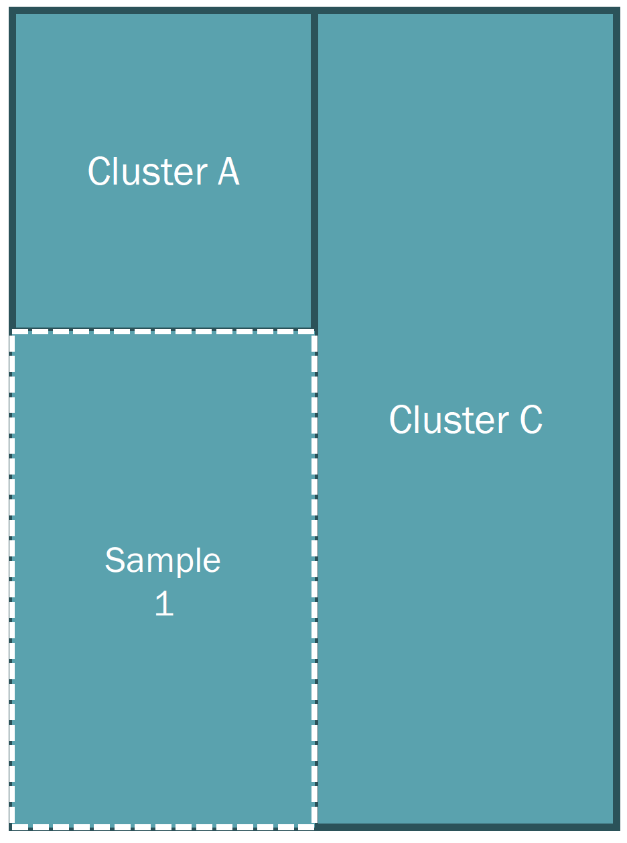
Cluster Sampling
After dividing the population into non-overlapping clusters, we select one (or multiple) clusters
Each cluster is representative of the population by its very nature – every cluster is a microcosm of the population

Slide 64
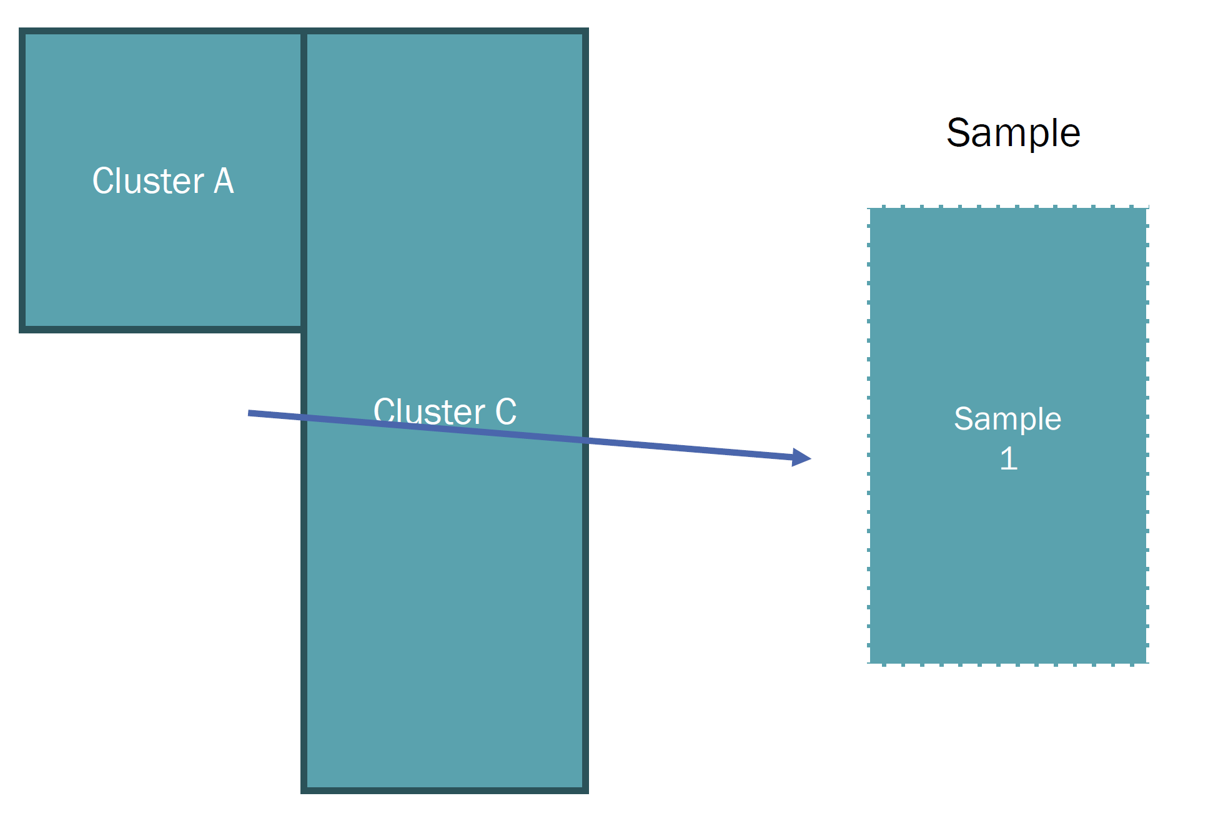
Cluster Sampling
Putting the cluster(s) together, we obtain our random sample

Slide 65
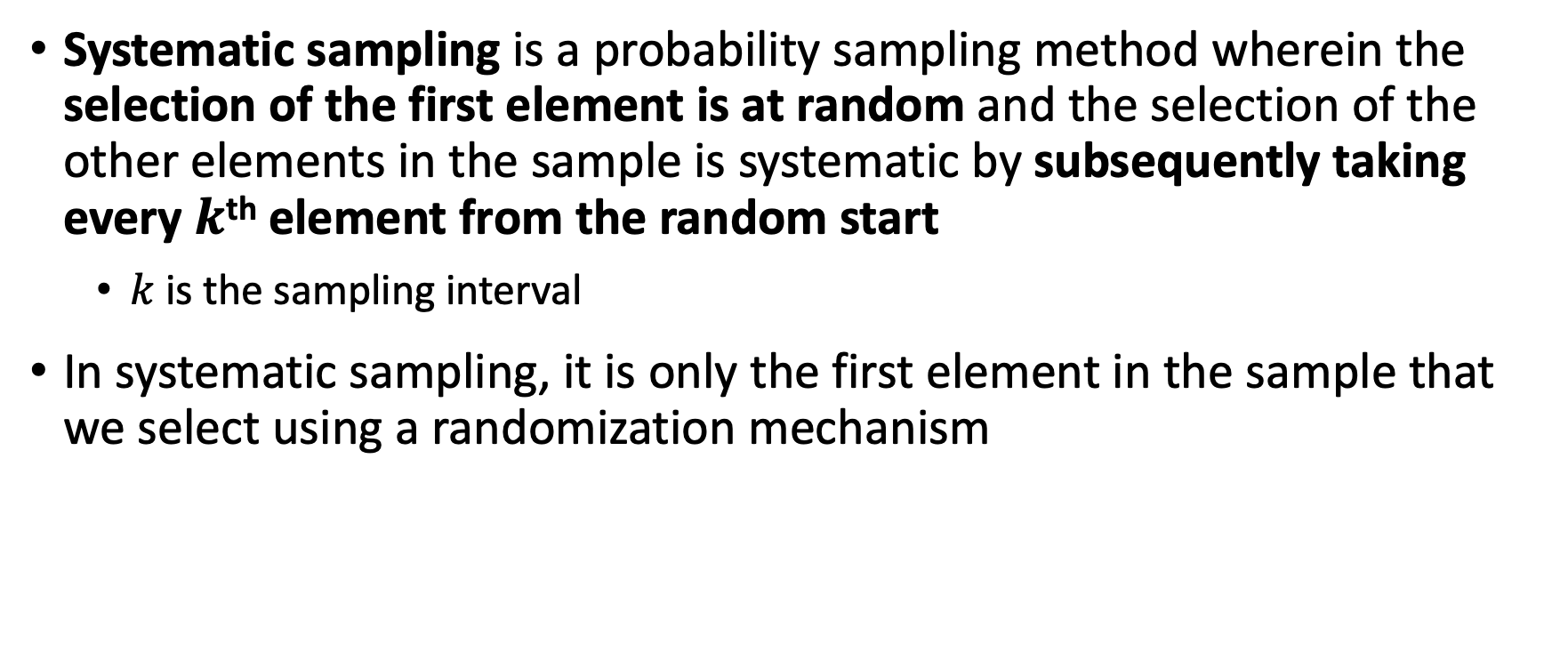
Systematic Sampling
Systematic sampling is a probability sampling method wherein the selection of the first element is at random and the selection of the other elements in the sample is systematic by subsequently taking every $k$^{th} element from the random start
$k$ is the sampling interval
In systematic sampling, it is only the first element in the sample that we select using a randomization mechanism

Slide 66
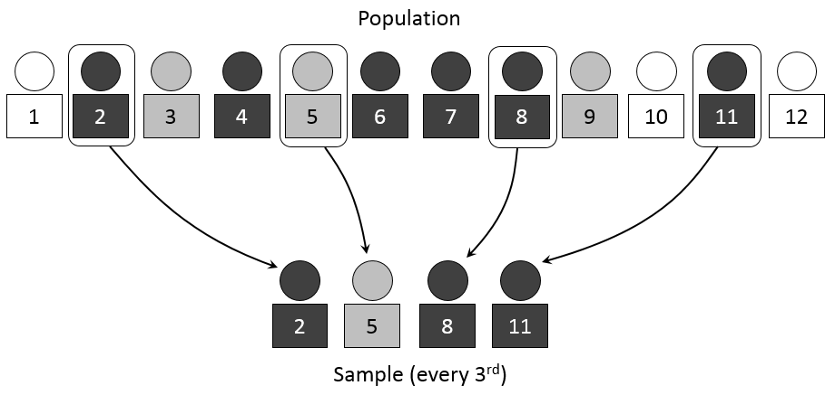
Systematic Sampling
Source: https://www.netquest.com/blog/en/systematic-sampling

Slide 67
Multi-stage Sampling
Multi-stage Sampling is a probability sampling method where there is a hierarchical configuration of sampling units and we select a sample of these units in stages
If the population is very large, multi-stage sampling is commonly done to trim down the sample size and arrive at a representative sample

Slide 68
Exercise on Sampling
I am interested to know about your perceptions on the quality of breakfast food being served in this hotel. For simplicity, I will take a sample of size 5 for each scheme
Scheme 1: SRS
Scheme 2: Systematic sampling
Scheme 3: Stratified sampling
Scheme 4: Cluster sampling
For the randomly selected respondents, please rate your breakfast experience from terrible (1) to perfect (5)

Slide 69
Sample Size Determination
Once we know what data to collect, and how to collect it, the natural question is: how large should the sample size be?
Obviously, the larger the sample size, the better. In fact, as the sample size gets larger, it approaches the population
In such a case, we no longer have sampling errors as we effectively have a census
However, surveying a large number of respondents will cost time, money, and other resources

Slide 70
Sample Size Determination
Power calculations determine our sample size. They depend on:
Effect size or minimum detectable effect – the larger the effect, the easier it is to detect, requiring a smaller sample size
Variability of the outcome indicator – the more variable this is, the more difficult to detect, requiring a larger sample size
Whether or not a clustering design is induced. With a clustering design, the clusters effectively serve as the observations (not the households or individuals)
Statistical power – threshold in committing a Type II error (false negative), the higher the power, the larger the sample size

Slide 71
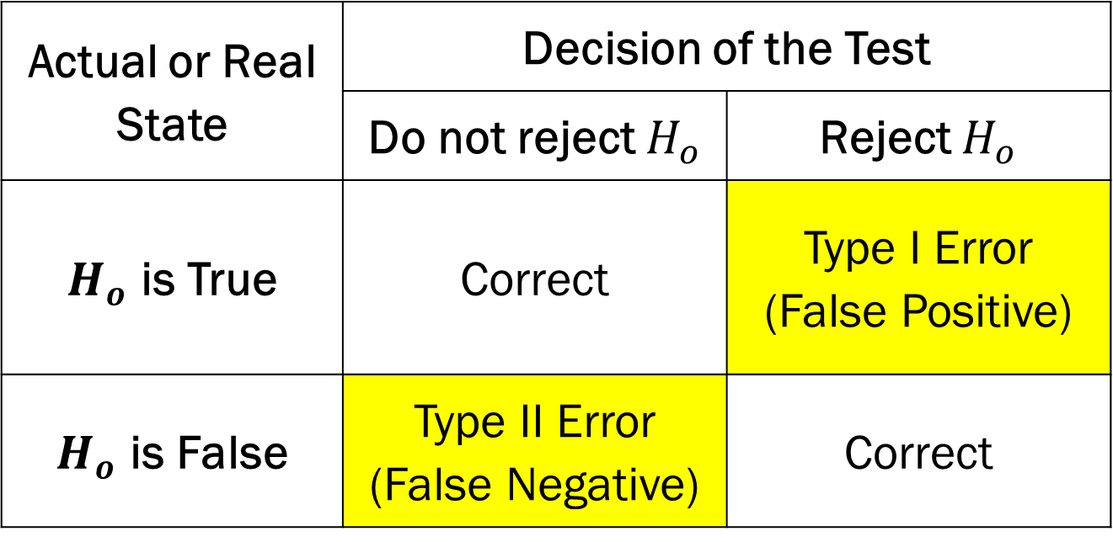
Statistical Power
Actual or Real State | Decision of the Test
 | Do not reject $H_{o}$ | Reject $H_{o}$
$H_{o}$ is True | Correct | Type I Error (False Positive)
$H_{o}$ is False | Type II Error (False Negative) | Correct
The null hypothesis, denoted by $H_{o},$ is that the intervention has no effect on outcomes.
Type 1 errors are controlled by $α$, while type 2 errors are controlled by $β$

Slide 72
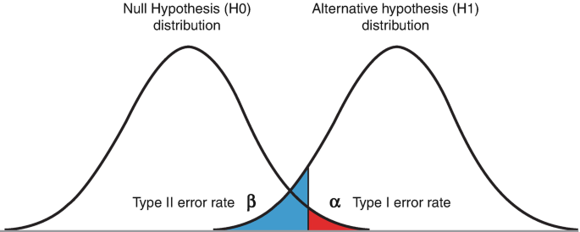
Type I and Type II Errors
Acceptance Region
Rejection Region

Slide 73
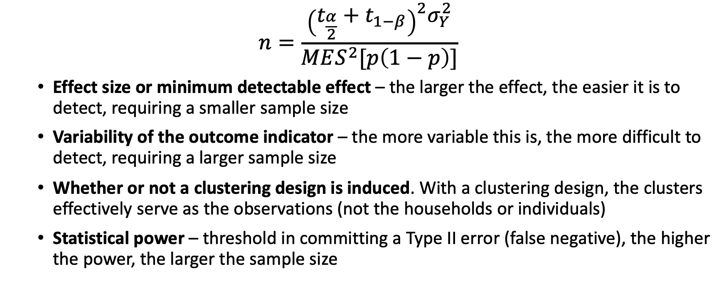
Sample Size Determination Determination
$$n=\frac{{\left(t_{\frac{α}{2}}+t_{1−β}\right)}^{2}σ_{Y}^{2}}{MES^{2}[p\left(1−p\right)]}$$
Effect size or minimum detectable effect – the larger the effect, the easier it is to detect, requiring a smaller sample size
Variability of the outcome indicator – the more variable this is, the more difficult to detect, requiring a larger sample size
Whether or not a clustering design is induced. With a clustering design, the clusters effectively serve as the observations (not the households or individuals)
Statistical power – threshold in committing a Type II error (false negative), the higher the power, the larger the sample size

Slide 74
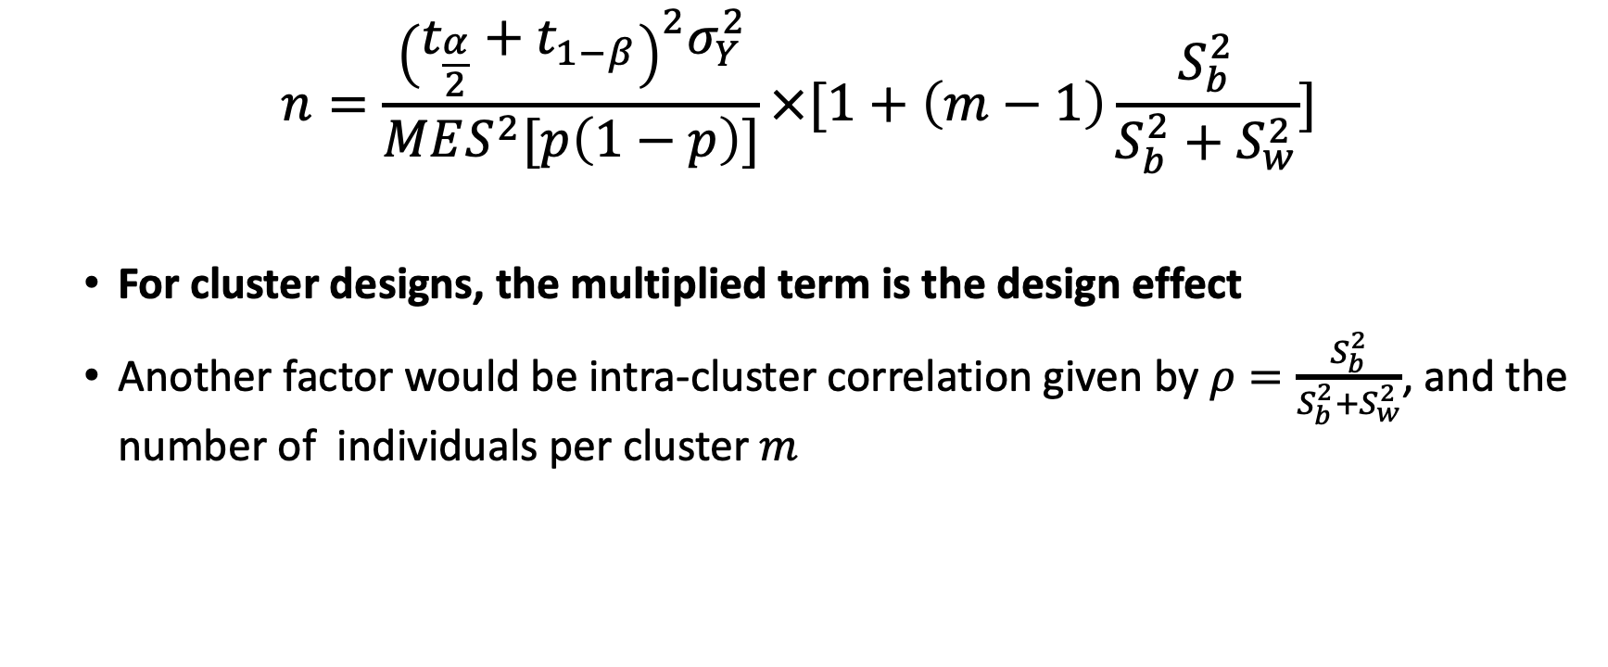
Sample Size Determination Determination
$$n=\frac{{\left(t_{\frac{α}{2}}+t_{1−β}\right)}^{2}σ_{Y}^{2}}{MES^{2}[p\left(1−p\right)]}×[1+\left(m−1\right)\frac{S_{b}^{2}}{S_{b}^{2}+S_{w}^{2}}]$$
For cluster designs, the multiplied term is the design effect
Another factor would be intra-cluster correlation given by $ρ=\frac{S_{b}^{2}}{S_{b}^{2}+S_{w}^{2}}$, and the number of individuals per cluster $m$

Slide 75
Survey Instruments

Slide 76
Designing a Survey
One may consider “piggybacking” or being a rider to a survey
Will be logistically and administratively easier as survey design and operations are done by the survey organization
Not necessarily quicker as layers of approval will be required
Need to ensure alignment on the unit of analysis
Example: if we wish to measure outcomes at the household-level, then the survey should be able to measure household-level characteristics

Slide 77
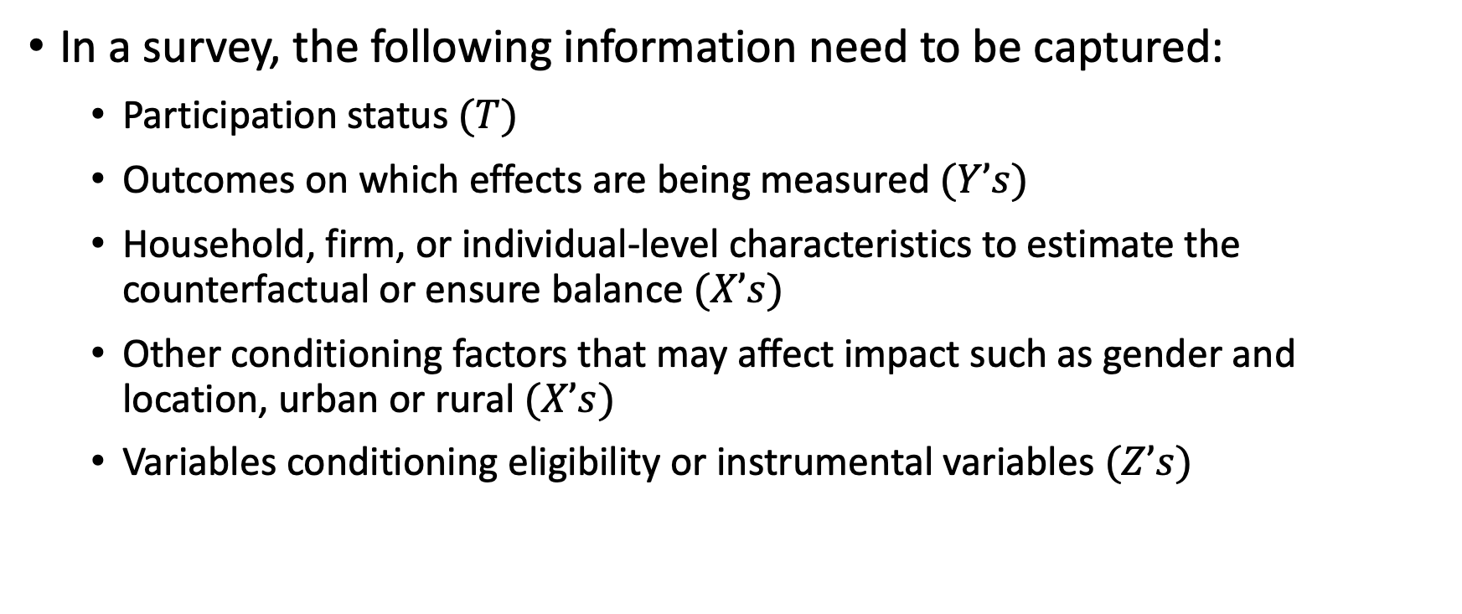
Designing a Survey
In a survey, the following information need to be captured:
Participation status $(T)$
Outcomes on which effects are being measured $(Y’s)$
Household, firm, or individual-level characteristics to estimate the counterfactual or ensure balance $(X’s)$
Other conditioning factors that may affect impact such as gender and location, urban or rural $(X’s)$
Variables conditioning eligibility or instrumental variables $(Z’s)$

Slide 78
Designing a Survey
If possible, the following information will also be captured:
Intermediate outcomes and process variables along the results chain
Details of respondents (in case of migration, drop out; for validation and follow-up)
Other variables for sub-group analysis and estimation of impact heterogeneity (e.g. male-led households vs female-led households, young vs old)

Slide 79
Survey Instruments
Household survey
Data are collected by a household visit, with the household head as the target respondent
Common questions: household roster and their sex, age, educational attainment, relationship to HH head, and context-specific questions
Enterprise survey
Firm-level survey, with the enterprise owner or manager as the target respondent
Common questions: employment, revenues, expenses, access to credit

Slide 80
Survey Instruments
Facility survey
Data are collected at the level of the facility, with the head of the facility as target respondent
Common questions: quantity and quality of services such as the number of classrooms, number of teachers, number of learners in a school
Community survey
Data are collected at the level of the community (e.g. barangay), with community leaders as target respondents
May be combined with FGDs for qualitative data
Common questions: community facilities, distance to municipal or provincial facilities, livelihood sources of community members

Slide 81
Survey Instruments
Agency survey
Data are collected at the level of the agency, such as an NGO, with the agency lead in the area as target respondent
Common questions: financial and human resources, procedures, target beneficiaries of an intervention
Worker survey
Data are collected from individual workers such as teachers, health workers, and government employees
Common questions: qualifications, job satisfaction, working environment, skills training

Slide 82
Survey Instruments
It is also possible to use several data sources and instruments
An evaluation’s own survey data may also be linked with other existing data sources
ID codes are crucial in allowing different instruments to be linked
Example: FIES-LFS data set
A coding system may be implemented such as PPCCBBHH, where the first two digits would be the provincial code, the next two digits the city code, the following two digits the barangay code, and the last two digits the household code

Slide 83
Design of Survey Questions
Survey questions should be BOSS (Iarossi, 2006):
Brief – to reduce cognitive load on respondents
Objective – to obtain unbiased responses
Simple – to reduce respondent fatigue
Specific – to ensure detailed information
Track quantitative information as continuous variables
Reduce information loss
Discretizing data is easy at the analysis stage

Slide 84
Design of Survey Questions
Survey questions should have a coherent skip pattern
Example: It shouldn’t ask the ages of the respondent’s children, if he/she specified that he/she has no children
Questions should not require implicit assumptions (e.g. background knowledge of a respondent on a certain domain)

Slide 85
Design of Survey Questions
Survey questions should be as disaggregated yet brief as possible
Example: It will be difficult for a respondent to estimate how much he/she earned over the last three years
Disaggregation allows for granular analysis (example: estimating total income)
Questionnaires should be iteratively tested before full deployment
Test it within the team
Test it with field encoders
Test it with a small subset of respondents
Scale and refine accordingly

Slide 86
Data Management

Slide 87
Data Management Practices
The data collection team is usually the one that manages the data for consistency
Some things to keep in mind:
Enumerator training and survey operations
Training on electronic data collection devices (computer-assisted survey information collection)
Data validation and quality assurance (data entry program, field testing, vetting with respondents and automated sanity checks)
Archiving of supporting documents (e.g. questionnaires, data dictionary, metadata)
Informed consent and privacy of respondents (masked or anonymized data)
Securing of approvals from relevant regulators

Slide 88
Different Impact Measures and the Required Data
If time permits

Slide 89
Different Impact Measures
Impact is measured at the unit of analysis, but impact for whom?
Different impact measures give us an idea on what data are needed to estimate the impact of a treatment/intervention
Average Treatment Effect (ATE) – average impact of treatment on the entire population
Average Treatment Effect on the Treated (ATT or TOT) - average impact of treatment on the treatment group
Average Treatment Effect on the Untreated (ATTU or TOU) – average potential impact of treatment on the comparison group

Slide 90
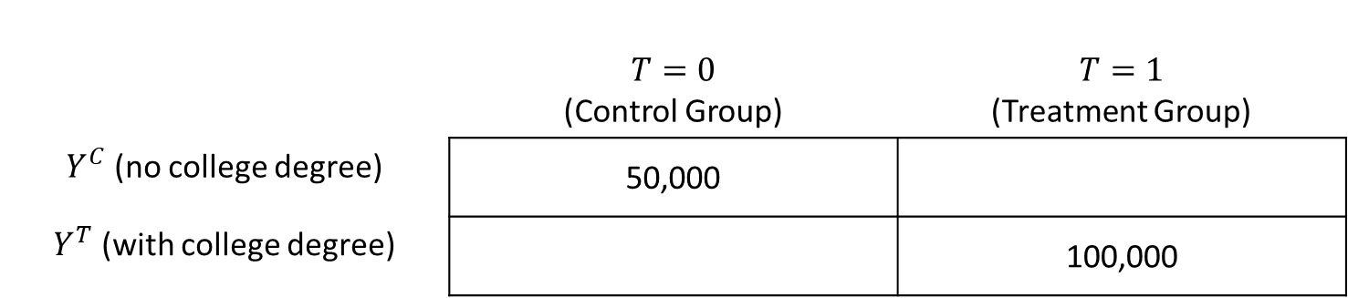
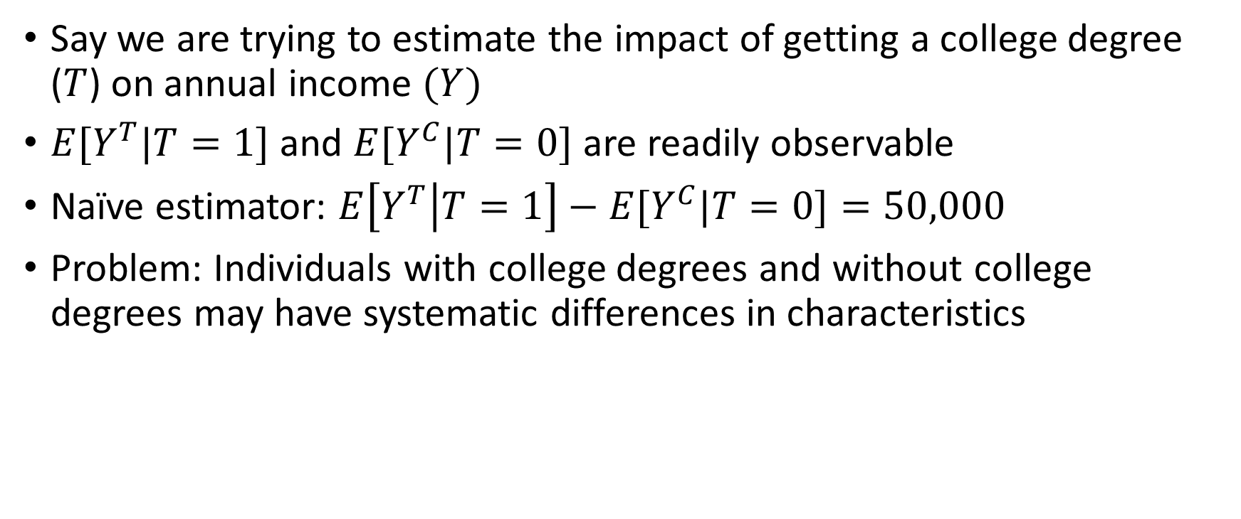
Different Impact Measures
Say we are trying to estimate the impact of getting a college degree ($T$) on annual income $(Y)$
$E[Y^{T}|T=1]$ and $E[Y^{C}|T=0]$ are readily observable
Naïve estimator: $E\left[Y^{T} | T=1\right]−E[Y^{C}|T=0]=50,000$
Problem: Individuals with college degrees and without college degrees may have systematic differences in characteristics
 | $$T=0$$ (Control Group) | $$T=1$$ (Treatment Group)
$Y^{C}$ (no college degree) | 50,000
$Y^{T}$ (with college degree) |  | 100,000

Slide 91
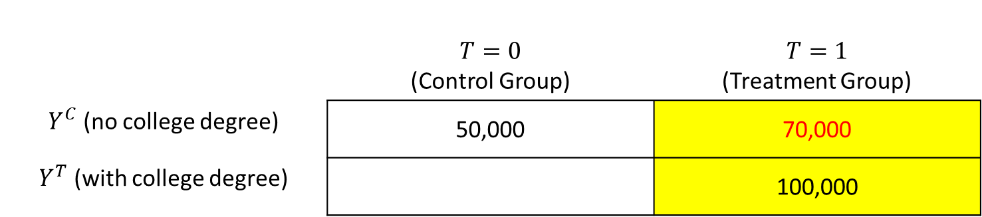
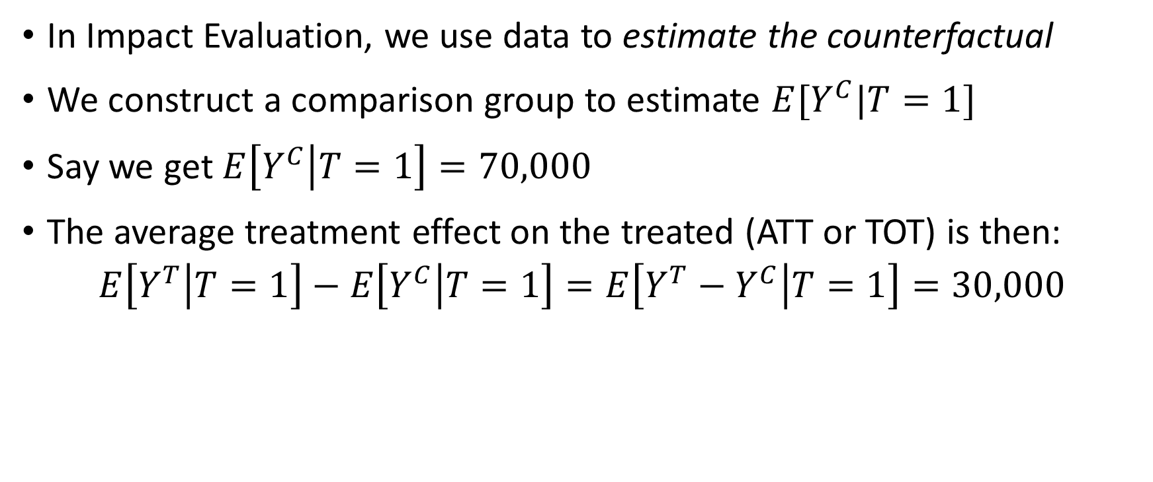
Different Impact Measures
In Impact Evaluation, we use data to estimate the counterfactual
We construct a comparison group to estimate $E[Y^{C}|T=1]$
Say we get $E\left[Y^{C} | T=1\right]=70,000$
The average treatment effect on the treated (ATT or TOT) is then:
$$E\left[Y^{T} | T=1\right]−E\left[Y^{C} | T=1\right]=E\left[Y^{T}−Y^{C} | T=1\right]=30,000$$
 | $$T=0$$ (Control Group) | $$T=1$$ (Treatment Group)
$Y^{C}$ (no college degree) | 50,000 | 70,000
$Y^{T}$ (with college degree) |  | 100,000

Slide 92
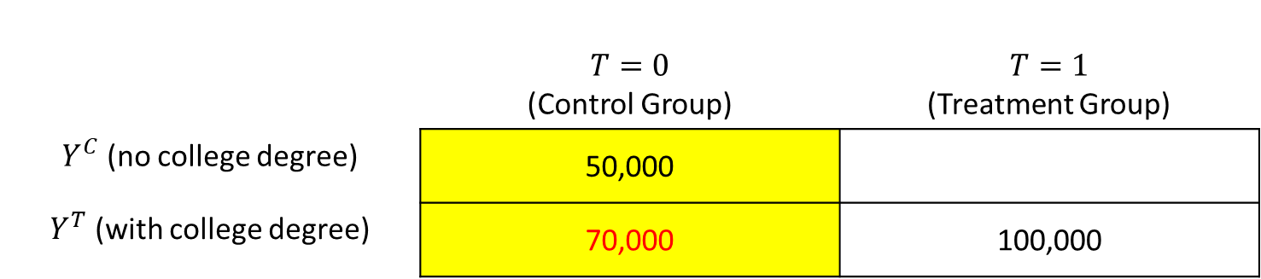
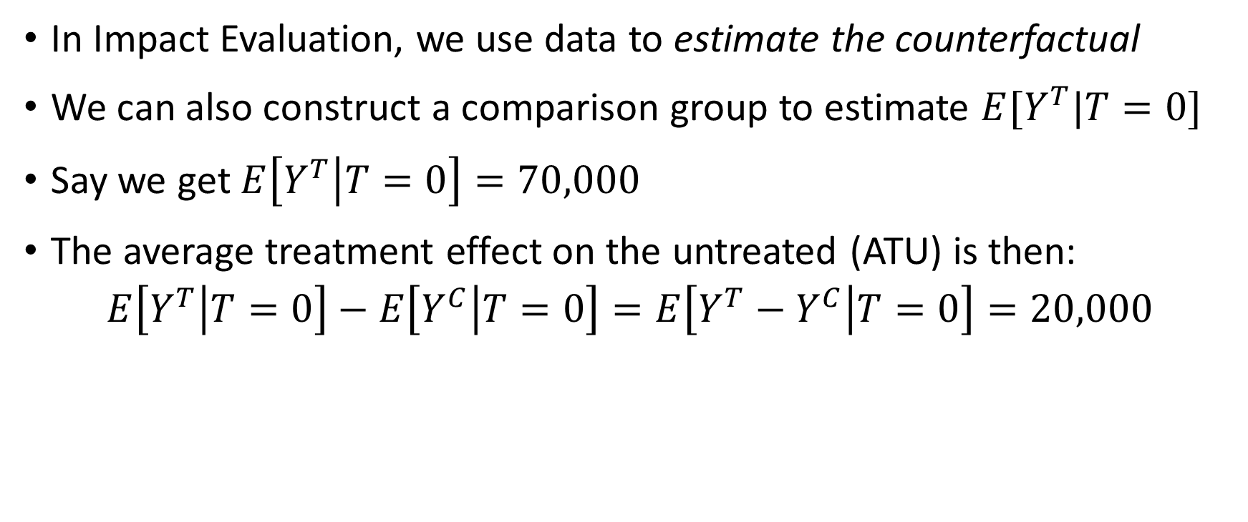
Different Impact Measures
In Impact Evaluation, we use data to estimate the counterfactual
We can also construct a comparison group to estimate $E[Y^{T}|T=0]$
Say we get $E\left[Y^{T} | T=0\right]=70,000$
The average treatment effect on the untreated (ATU) is then:
$$E\left[Y^{T} | T=0\right]−E\left[Y^{C} | T=0\right]=E\left[Y^{T}−Y^{C} | T=0\right]=20,000$$
 | $$T=0$$ (Control Group) | $$T=1$$ (Treatment Group)
$Y^{C}$ (no college degree) | 50,000
$Y^{T}$ (with college degree) | 70,000 | 100,000

Slide 93
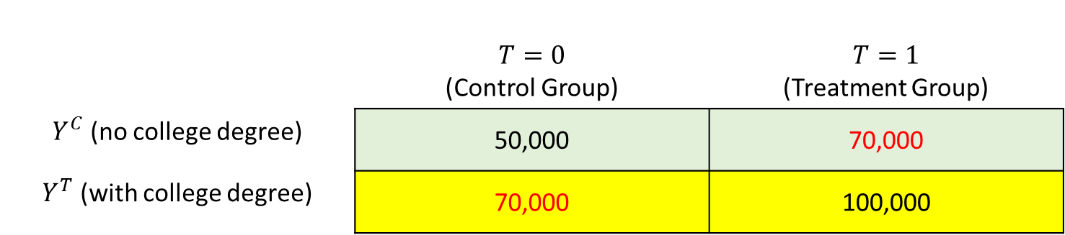
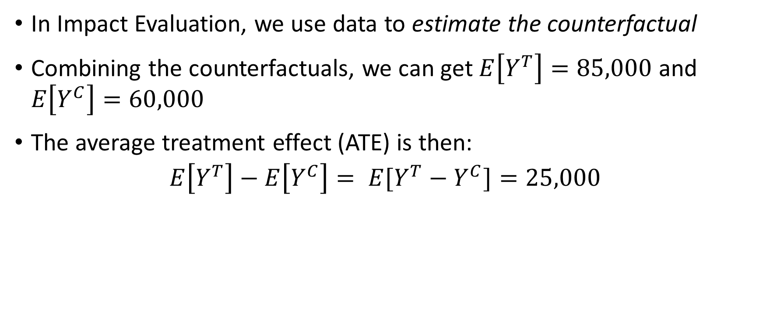
Different Impact Measures
In Impact Evaluation, we use data to estimate the counterfactual
Combining the counterfactuals, we can get $E\left[Y^{T}\right]=85,000$ and $E\left[Y^{C}\right]=60,000$
The average treatment effect (ATE) is then:
$$E\left[Y^{T}\right]−E\left[Y^{C}\right]= E[Y^{T}−Y^{C}]=25,000$$
 | $$T=0$$ (Control Group) | $$T=1$$ (Treatment Group)
$Y^{C}$ (no college degree) | 50,000 | 70,000
$Y^{T}$ (with college degree) | 70,000 | 100,000

Slide 94
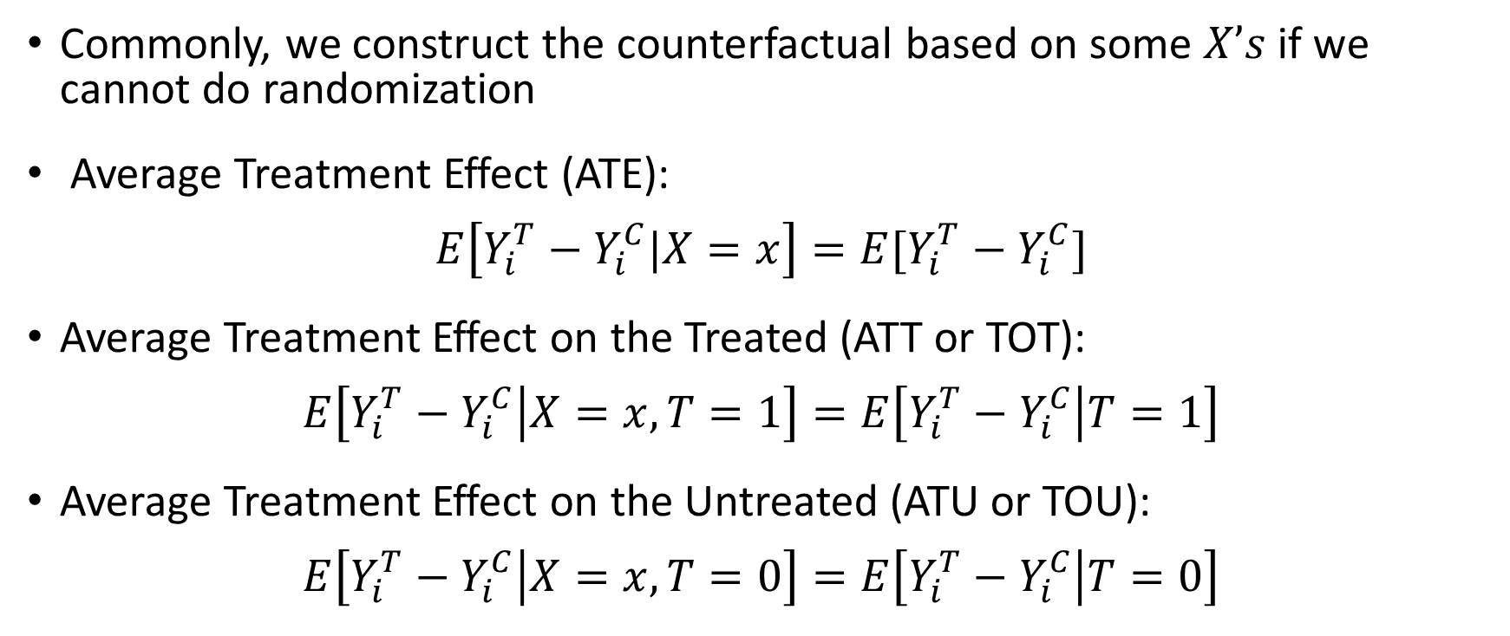
Different Impact Measures
Commonly, we construct the counterfactual based on some $X’s$ if we cannot do randomization
Average Treatment Effect (ATE):
$$E\left[Y_{i}^{T}−Y_{i}^{C}|X=x\right]=E[Y_{i}^{T}−Y_{i}^{C}]$$
Average Treatment Effect on the Treated (ATT or TOT):
$$E\left[Y_{i}^{T}−Y_{i}^{C} | X=x,T=1\right]=E\left[Y_{i}^{T}−Y_{i}^{C} | T=1\right]$$
Average Treatment Effect on the Untreated (ATU or TOU):
$$E\left[Y_{i}^{T}−Y_{i}^{C} | X=x,T=0\right]=E\left[Y_{i}^{T}−Y_{i}^{C} | T=0\right]$$

Slide 95
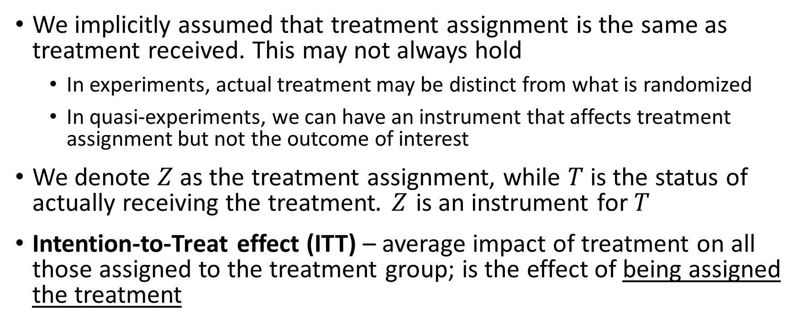
Different Impact Measures
We implicitly assumed that treatment assignment is the same as treatment received. This may not always hold
In experiments, actual treatment may be distinct from what is randomized
In quasi-experiments, we can have an instrument that affects treatment assignment but not the outcome of interest
We denote $Z$ as the treatment assignment, while $T$ is the status of actually receiving the treatment$. Z$ is an instrument for $T$
Intention-to-Treat effect (ITT) – average impact of treatment on all those assigned to the treatment group; is the effect of being assigned the treatment

Slide 96
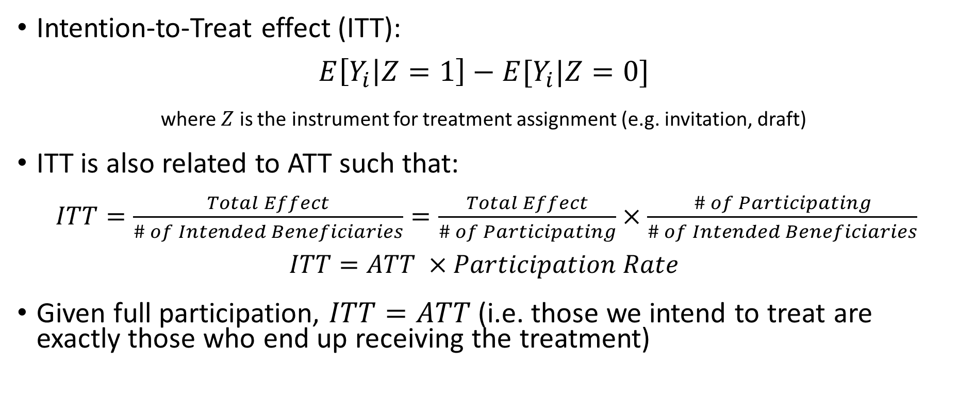
Different Impact Measures
Intention-to-Treat effect (ITT):
$$E\left[Y_{i} | Z=1\right]−E[Y_{i}|Z=0]$$
where $Z$ is the instrument for treatment assignment (e.g. invitation, draft)
ITT is also related to ATT such that:
$ITT=\frac{Total Effect}{\# of Intended Beneficiaries}=\frac{Total Effect}{\# of Participating}×\frac{\# of Participating}{\# of Intended Beneficiaries}$
$$ITT=ATT ×Participation Rate$$
Given full participation, $ITT=ATT$ (i.e. those we intend to treat are exactly those who end up receiving the treatment)

Slide 97
Different Impact Measures
Another factor we have to take into account is compliance. Assignment of treatment does not always coincide with receiving the treatment
Looking at the ITT will not yield the effect of treatment itself if some observations do not comply with the assigned treatment
Local Average Treatment Effect (LATE) – average impact of treatment for those who comply with the assignment of treatment
LATE is also called CATE (complier average treatment effect or conditional average treatment effect for compliers)

Slide 98
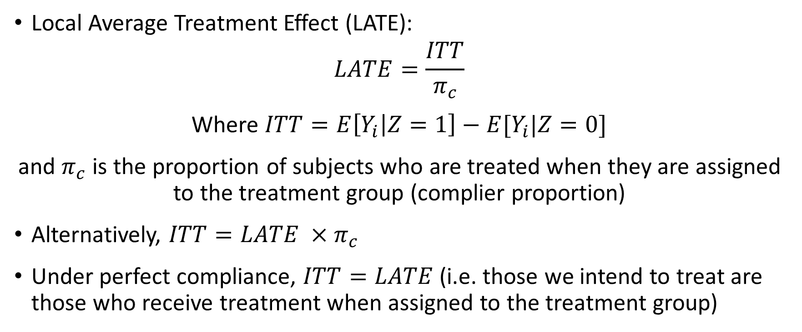
Different Impact Measures
Local Average Treatment Effect (LATE):
$$LATE=\frac{ITT}{π_{c}}$$
Where $ITT=E\left[Y_{i} | Z=1\right]−E[Y_{i}|Z=0]$
and $π_{c}$ is the proportion of subjects who are treated when they are assigned to the treatment group (complier proportion)
Alternatively, $ITT=LATE ×π_{c}$
Under perfect compliance, $ITT=LATE$ (i.e. those we intend to treat are those who receive treatment when assigned to the treatment group)

Slide 99
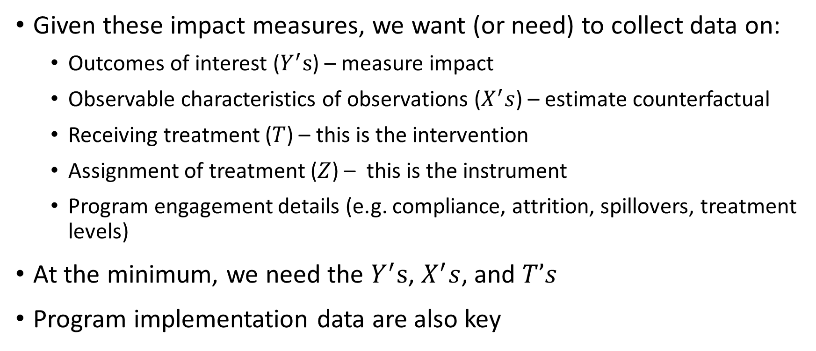
Role of Data in Impact Evaluation
Given these impact measures, we want (or need) to collect data on:
Outcomes of interest ($Y^{′}s$) – measure impact
Observable characteristics of observations ($X^{′}s$) – estimate counterfactual
Receiving treatment ($T$) – this is the intervention
Assignment of treatment ($Z$) – this is the instrument
Program engagement details (e.g. compliance, attrition, spillovers, treatment levels)
At the minimum, we need the $Y^{′}s$, $X^{′}s$, and $T’s$
Program implementation data are also key

Slide 100
Case Study: Impact Evaluation on DepEd’s School-Based Feeding Program
Authors: Tabunda, Albert, Angeles-Agdeppa (2016)
PIDS Discussion Paper Series No. 2016-05

Slide 101
IE of DepEd’s School-Based Feeding Program (SBFP)
For SY 2013-2014, 7.2% of over 500,000 severely wasted students were covered by a school-based feeding program that lasted from 100-120 days
Program | Unit of Assignment | Unit of Treatment | Unit of Analysis
School-Based Feeding Program (DepEd) | Public schools | School children between Kinder to Grade 6 identified as ‘severely wasted’ | Students, parents, teachers, school heads
Students are fed meals of at least 300 calories (recipes with malunggay) for 100 to 120 days | Treatment was assigned to DepEd-identified schools based on SW prevalence and management capability | Treatment was delivered to primary school students with extremely low weight-for-height | Treatment is supposed to improve children’s nutrition from severe wasting to normal weight

Slide 102
IE of DepEd’s School-Based Feeding Program
Sample evaluation problem:
What will be the nutrition status of severely wasted students if they had not been given free meals under the 120-day feeding program?
What are possible reasons why it’s difficult to construct a counterfactual for your treatment group?
There are other factors affecting nutrition status beyond the school setting (some may have good quality food at home while others don’t)
There is no available data to construct the counterfactual

Slide 103
Inputs | Activities | Outputs | Outcomes (Short and Medium-Term) | Final Outcomes
I’ll give you 15 minutes to initially fill out this table

Slide 104
Inputs | Activities | Outputs | Outcomes (Short and Medium-Term) | Final Outcomes
Budget (P15/day for 300-calorie meals) | Meal preparation (standardized menu with malunggay and 20-day cycle menu) | Nutritious meals provided to severely wasted kids | Severely wasted students are fed nutritious meals | Reduced prevalence of malnutrition, hunger and poverty
Volunteer teachers, parents | Measure pre-feeding program and post-feeding program weight of students | Provision sustained for 100-120 days | Students gain more weight proper to height | Better learning outcomes, school completion
Cooking facilities and utensils | Training on School-Based Management to help schools manage, disburse and liquidate funds |  | Students attend school more often, participate more in class discussions | Improved job prospects and income generation abilities

Slide 105
Formulating the Evaluation Question(s)
Did the school-based feeding program rehabilitate at least 70% of the severely wasted beneficiaries to normal nutritional status?
There’s a concrete goal – we can say if the program is a success or a failure. Likewise, there’s a targeted direction and magnitude of effect (i.e. effect size)
The SBFP study has secondary targets like improved school attendance and increased student attentiveness during lectures. These can be evaluation questions too

Slide 106
SBFP Example: Getting the Data Right
Data Sources – mostly utilized beneficiary information from SBFP forms and surveys
Administrative data (related to the SBFP)
Survey data
Data Collection Instruments – mostly surveys; manual data and management information system data on SBFP
Household survey - survey of pupils and parents (treatment and comparison groups)
Facility survey - interviews of school heads (treatment and comparison groups)

Slide 107
SBFP Example: Getting the Data Right
Qualitative Data – collected qualitative data in a mixed-methods research framework
Qualitative surveys and FGDs
Preceded by a process evaluation
Sampling Design – utilized a two-stage stratified sampling methodology
Stage 1: Random selection of 44 beneficiary schools using the sampling frame of beneficiary schools based on region clusters and number of beneficiary children
Stage 2: Systematic sampling of beneficiary (and NB) pupils using each school’s list of beneficiary pupils ordered by grade level
Target sample size was 1,210 beneficiaries

Slide 108
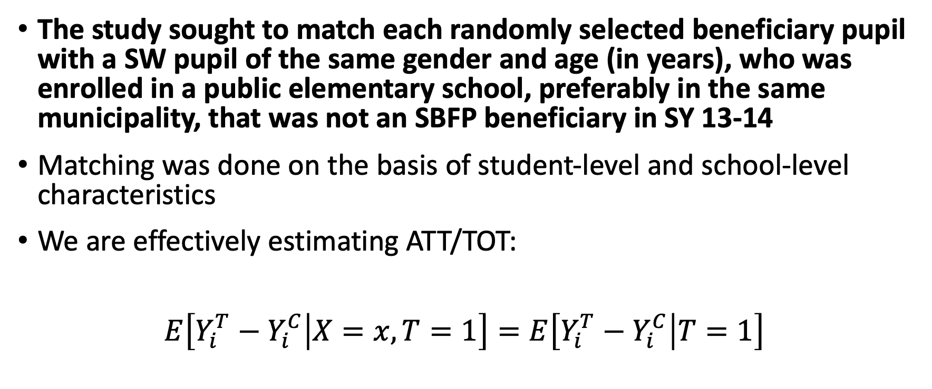
SBFP Example: Getting the Data Right
The study sought to match each randomly selected beneficiary pupil with a SW pupil of the same gender and age (in years), who was enrolled in a public elementary school, preferably in the same municipality, that was not an SBFP beneficiary in SY 13-14
Matching was done on the basis of student-level and school-level characteristics
We are effectively estimating ATT/TOT:
$$E\left[Y_{i}^{T}−Y_{i}^{C} | X=x,T=1\right]=E\left[Y_{i}^{T}−Y_{i}^{C} | T=1\right]$$

Slide 109
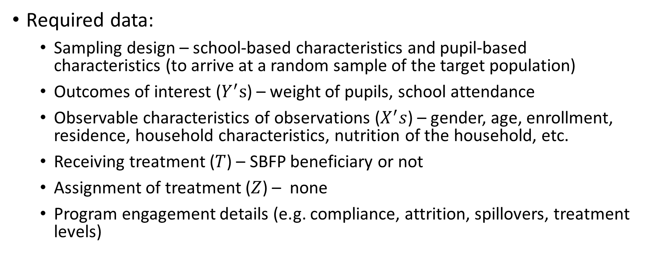
SBFP Example: Getting the Data Right
Required data:
Sampling design – school-based characteristics and pupil-based characteristics (to arrive at a random sample of the target population)
Outcomes of interest ($Y^{′}s$) – weight of pupils, school attendance
Observable characteristics of observations ($X^{′}s$) – gender, age, enrollment, residence, household characteristics, nutrition of the household, etc.
Receiving treatment ($T$) – SBFP beneficiary or not
Assignment of treatment ($Z$) – none
Program engagement details (e.g. compliance, attrition, spillovers, treatment levels)

Slide 110

Data Challenges for the Impact Evaluation
The quality of evaluation is only as good as the quality of the data!
In this case a lot of observations were lost due to missing data

Slide 111
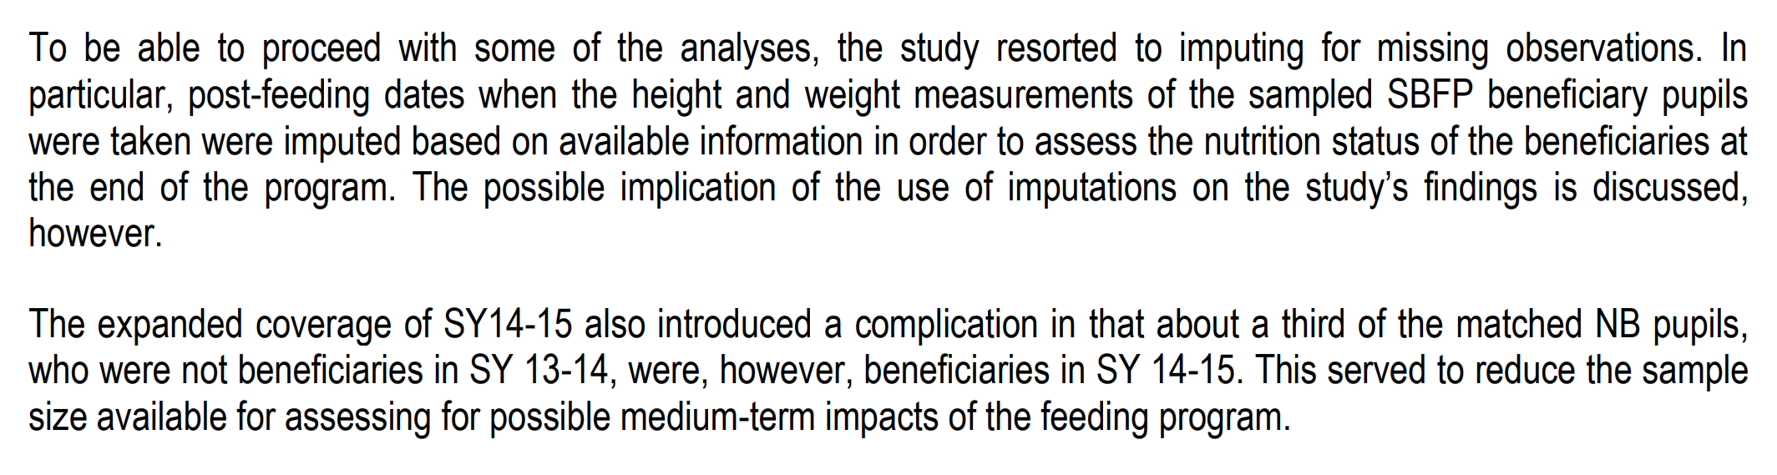
Data Challenges for the Impact Evaluation
“Creativity” may be required to reduce information loss
(no data = no evaluation)
Spillover effects also have to be considered

Slide 112
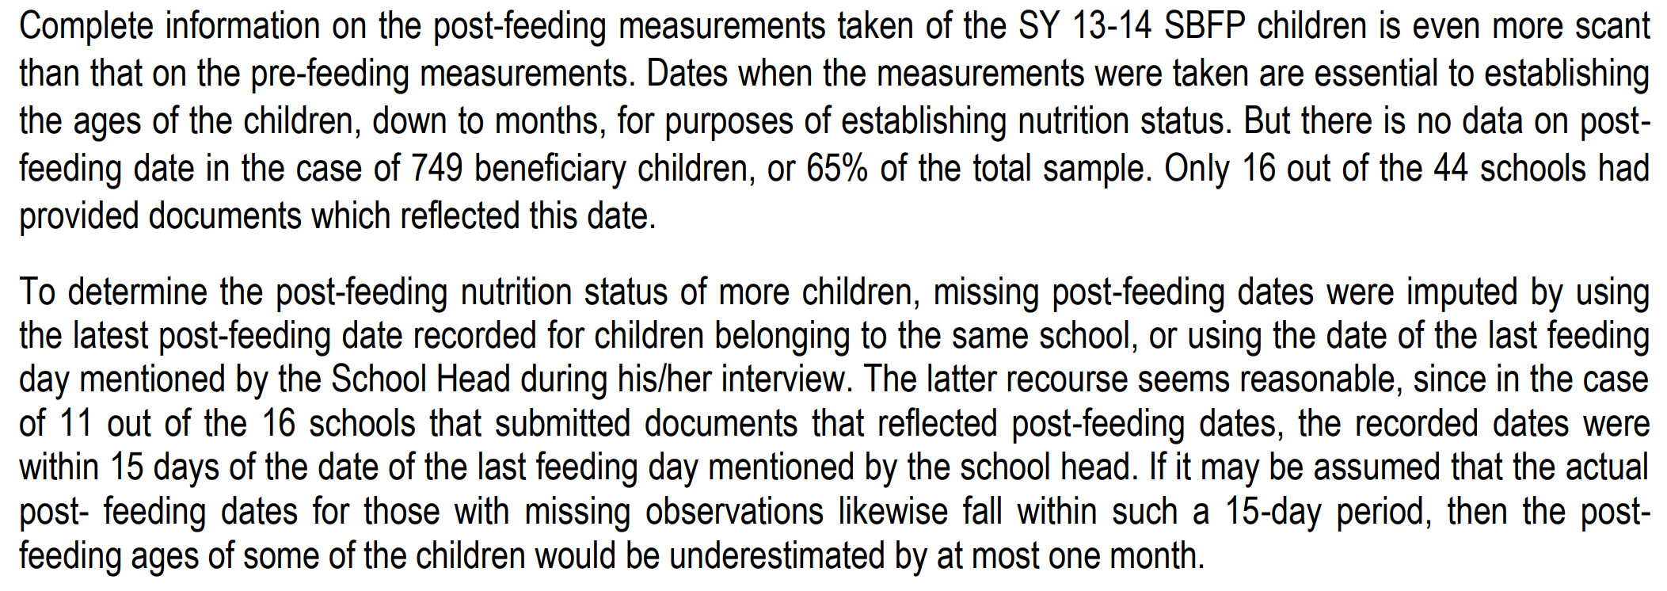
Data Challenges for the Impact Evaluation
Poor implementation = poor data = difficult evaluation design

Slide 113
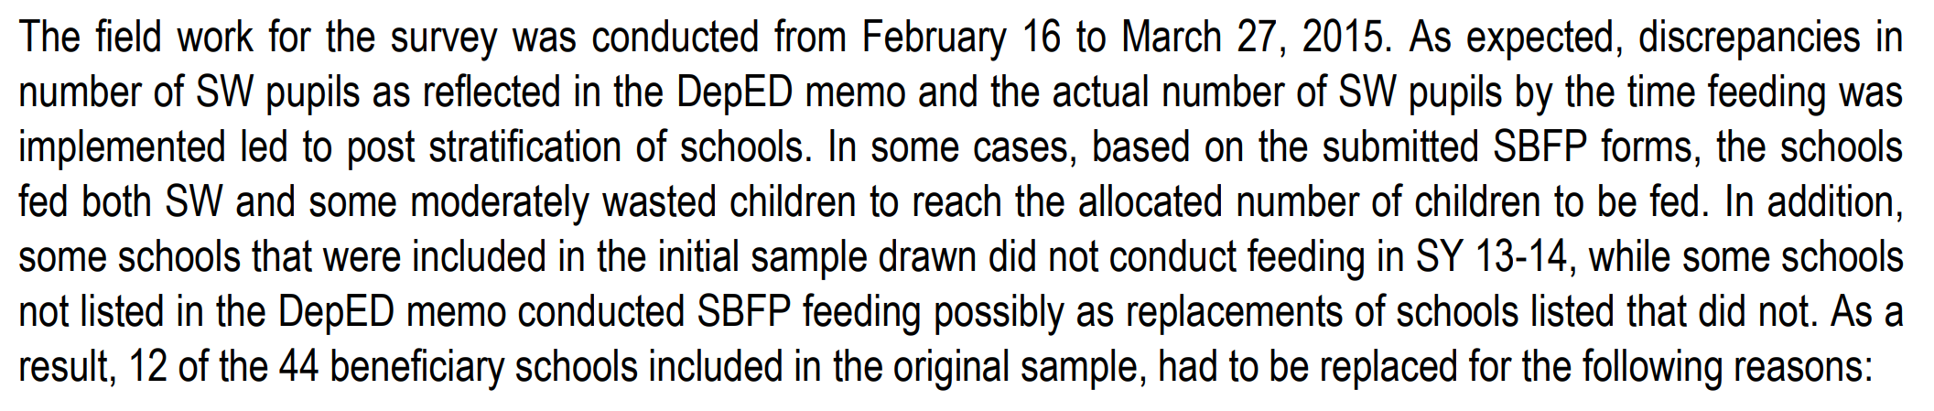
Data Challenges for the Impact Evaluation
Implementation indicators are crucial!
In this case, treatment assignment wasn’t strictly adhered to

Slide 114
Data Challenges for the Impact Evaluation
Implementation indicators are crucial!
In this case, some beneficiaries shouldn’t have received treatment if we were to follow the strict SW criterion

Slide 115
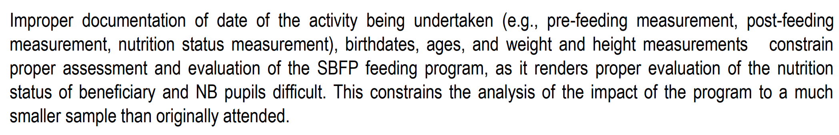
Data Challenges for Impact Evaluation
To adequately measure impact, we should measure the change in outcomes attributable to the program
For a fair measure of program outcomes, inputs, activities, and outputs (from the ToC) should have been delivered as designed
(i.e. policy vs implementation)

Slide 116
Question and Answer

